Slide 1


Ontology of Secrets (Part 1)
John Beverley
Assistant Professor, University at Buffalo
Co-Director, National Center for Ontological Research
Affiliate Faculty, Institute of Artificial Intelligence and Data Science

Slide 2
Outline
The Prevalence of Secrets
Hallmarks of Secrets
Lies, Deception, and Secrets

Slide 3
Outline
The Prevalence of Secrets
Hallmarks of Secrets
Lies, Deception, and Secrets

Slide 4
Secrets
The worst kept secret is that secrets are everywhere
We all conceal, we all withhold, and we all deceive at one more points in our lives
Secrets are a fixture of communication, social interactions, political engagement, military strategy, and economic protection

Slide 5
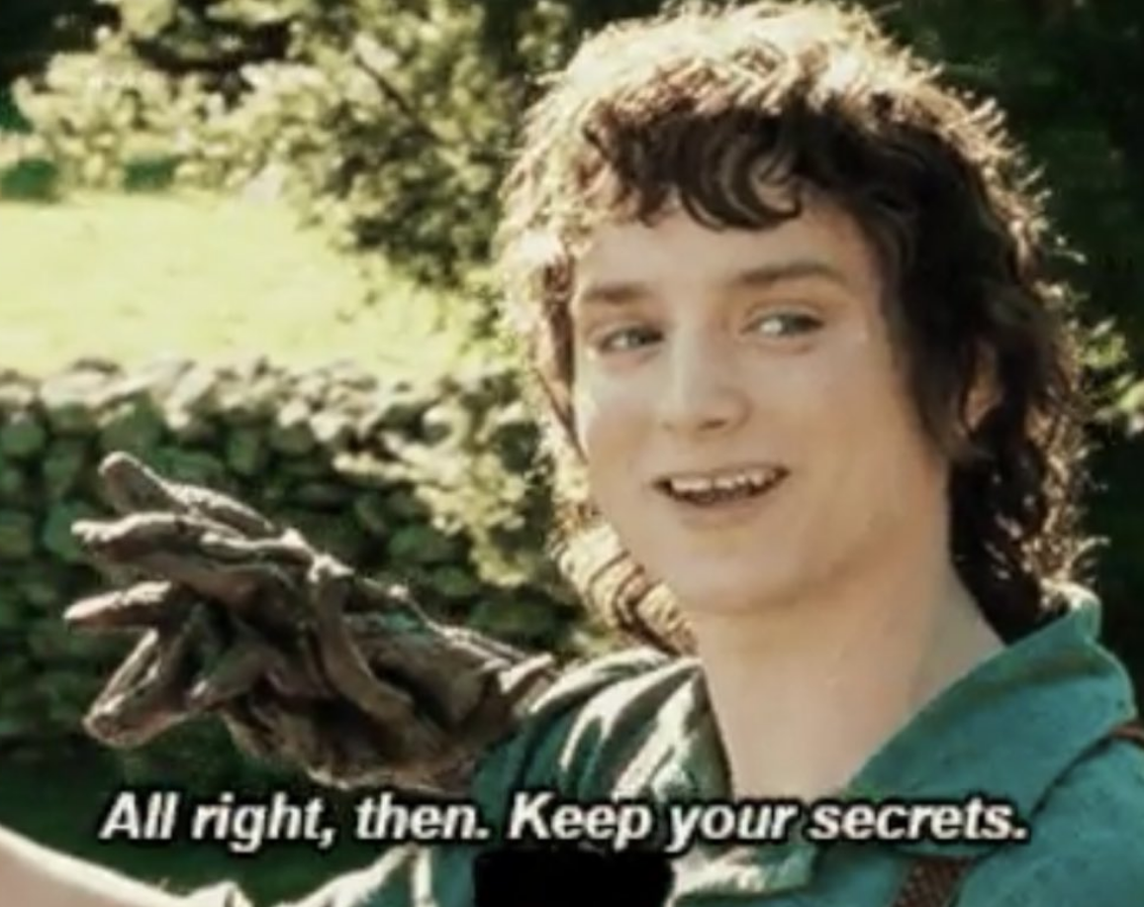
Secrets among Friends
Sometimes secrets must be kept to protect a friendship
Sometimes secrets are ignored because there is fear revelation will undermine the friendship

Slide 6
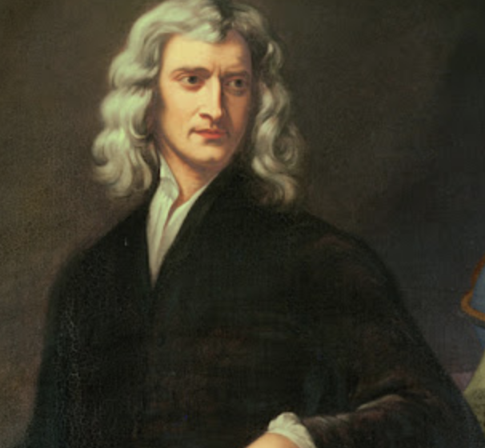
Personal Secrets
Isaac Newton is among the most famous physicists – or ‘natural philosophers’ as they were known at the time – in history
200 years after his death, it was discovered that he spent a significant amount of his time attempting to convert lead into gold
And was a member of a secret society of alchemists...

Slide 7
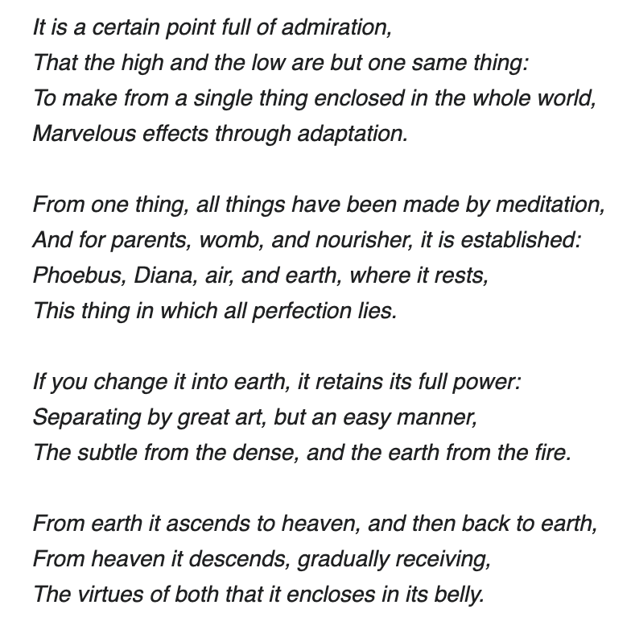
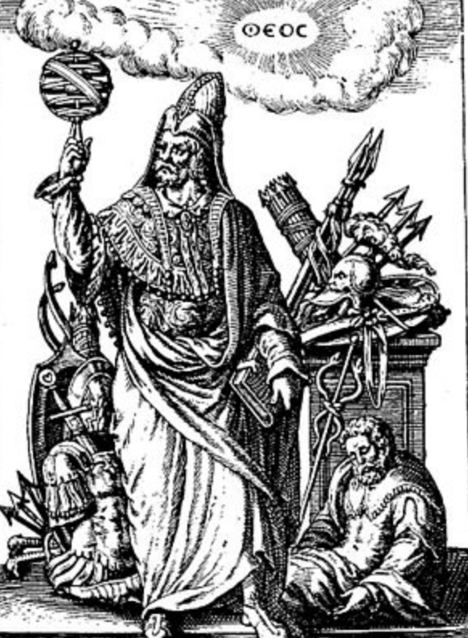
Secret Societies
Newton – along with many intellectuals at the time – followed the presumed teachings of hermes thrice-great

Slide 8
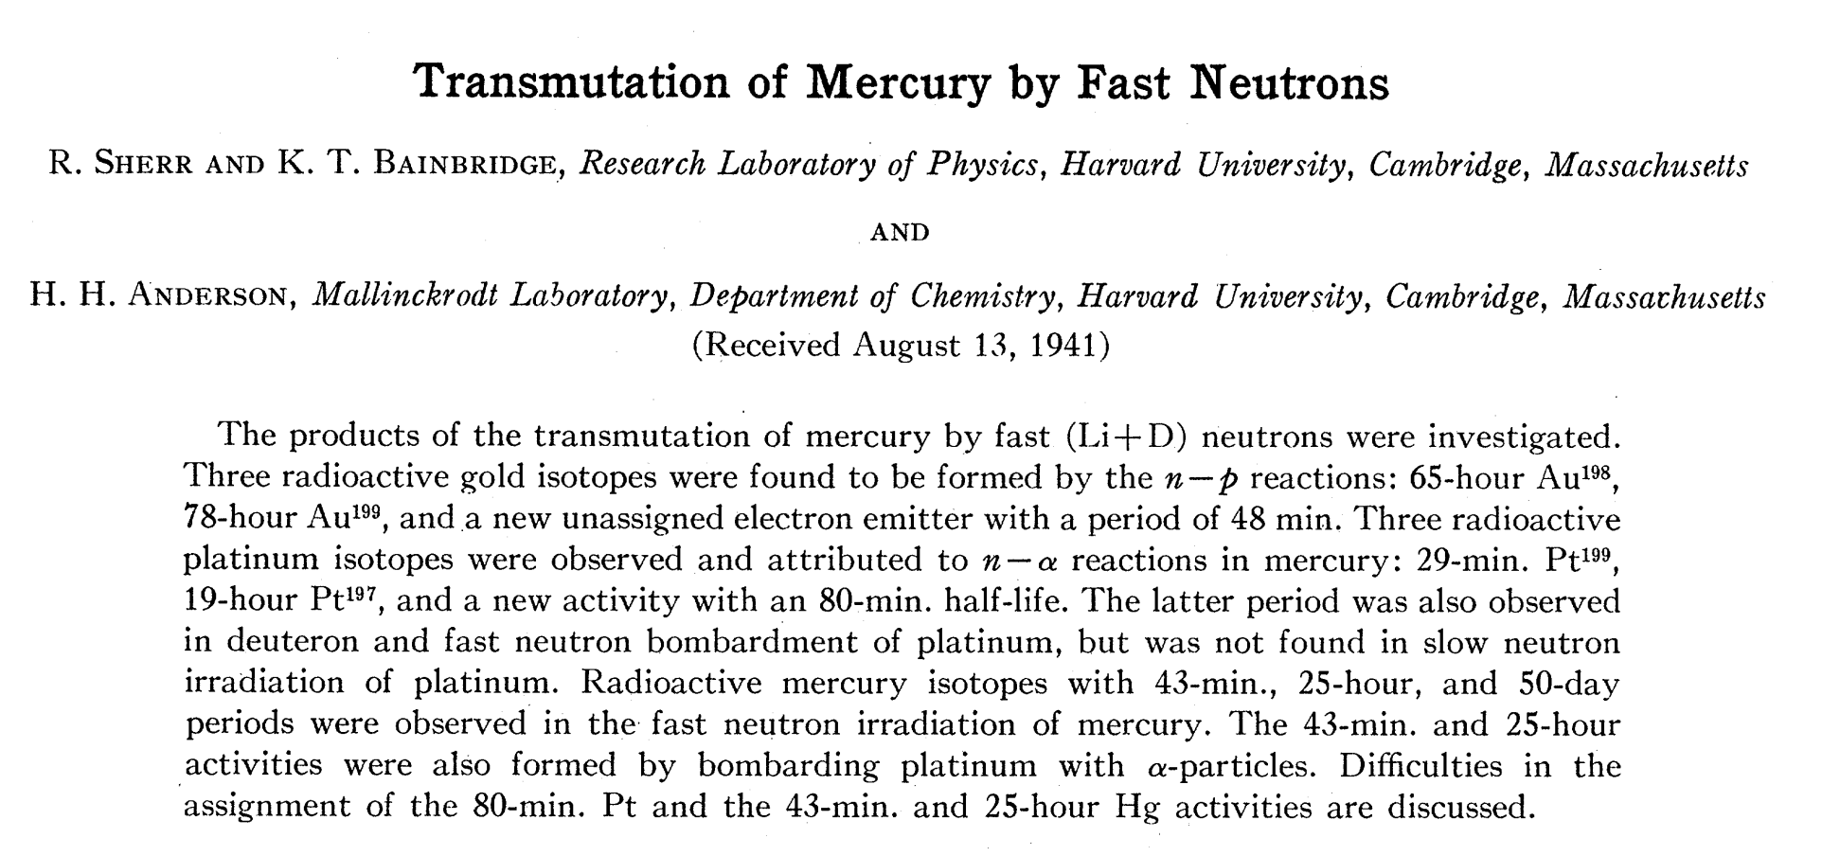
Simmel
Information deemed valuable likely leads to secret societies form around that information
Ingroup information threatened by the outgroup likely leads to secret societies form around that information

Slide 9
Trade Secrets
Codified in international law under the Agreement on Trade-Related Aspects of Intellectual Property Rights (TRIPS) as information that:
Is not generally known to the public
Confers economic benefit because it is not publicly known
And is such that the owner makes reasonable efforts to maintain its secrecy
The US Espionage Act of 1996 defines a trade secret as being information for which reasonable efforts are taken to protect that derives economic value from not being publicly known

Slide 10
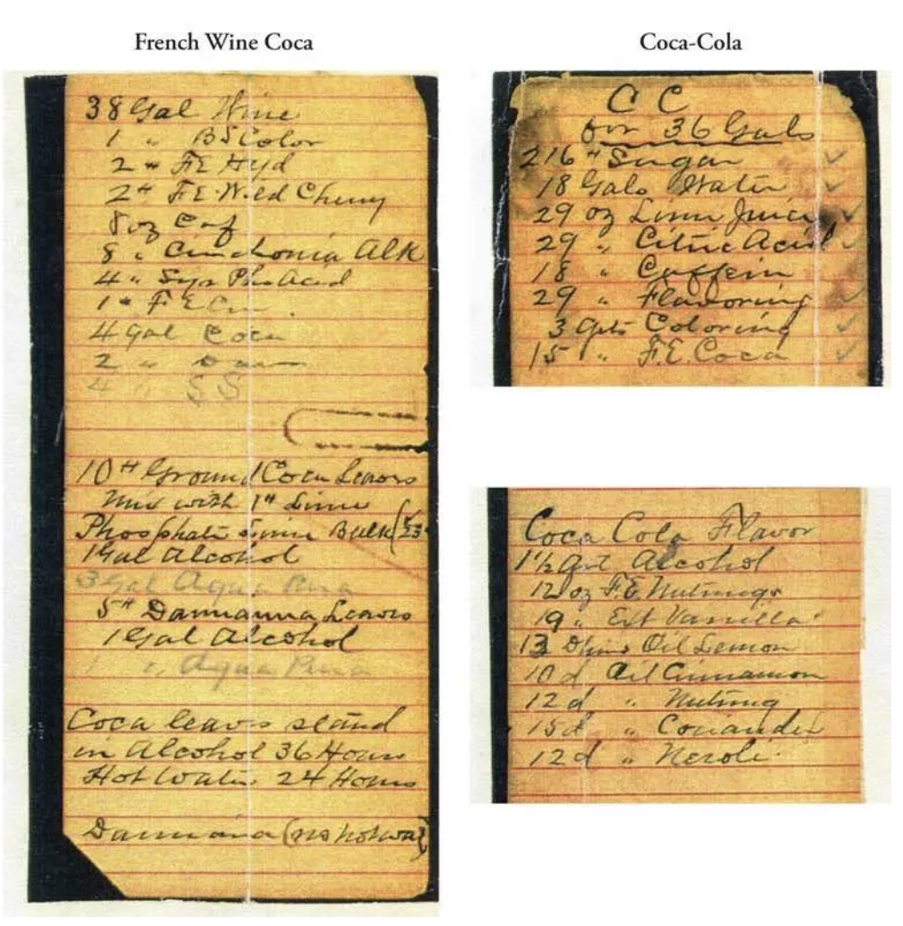
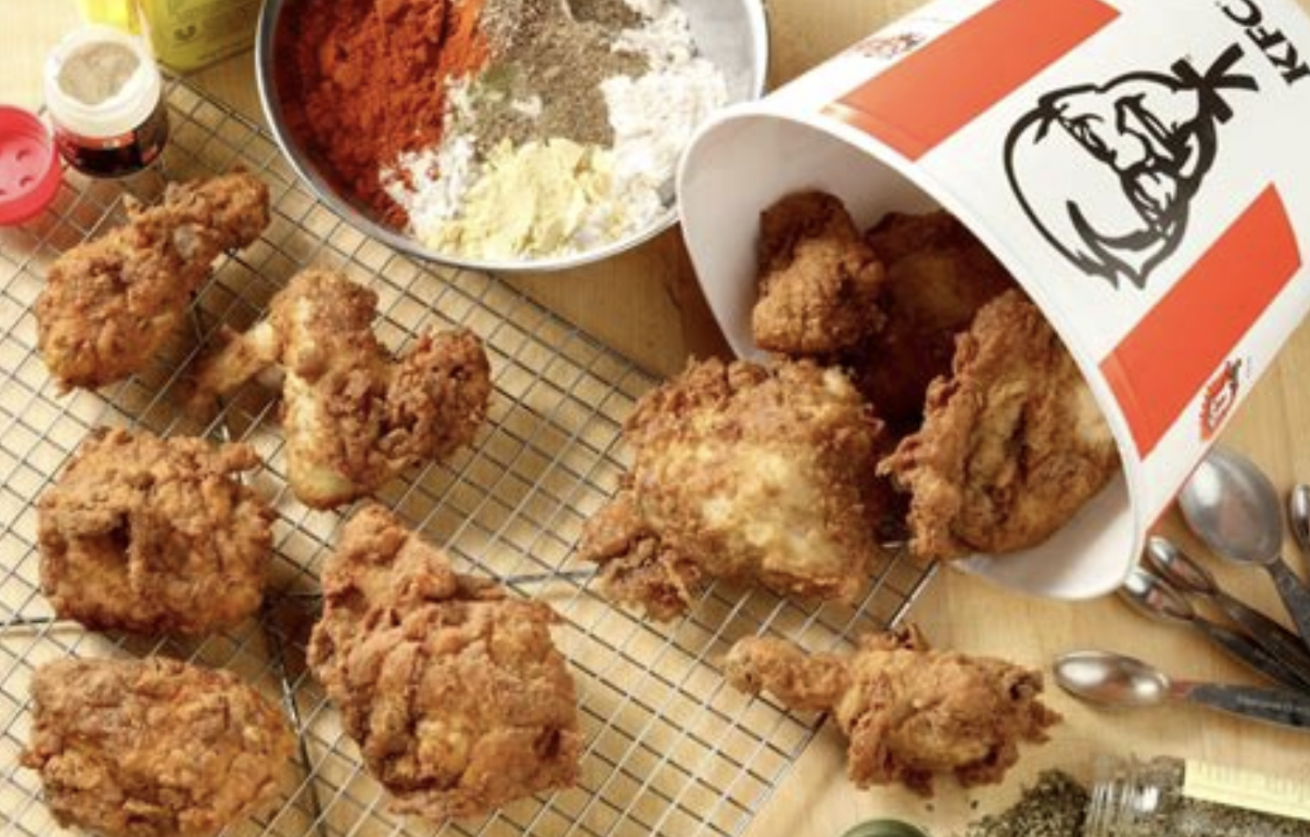
Trade Secrets
11 herbs and spices, but which ones?
Cocaine and caffeine, but how much?

Slide 11
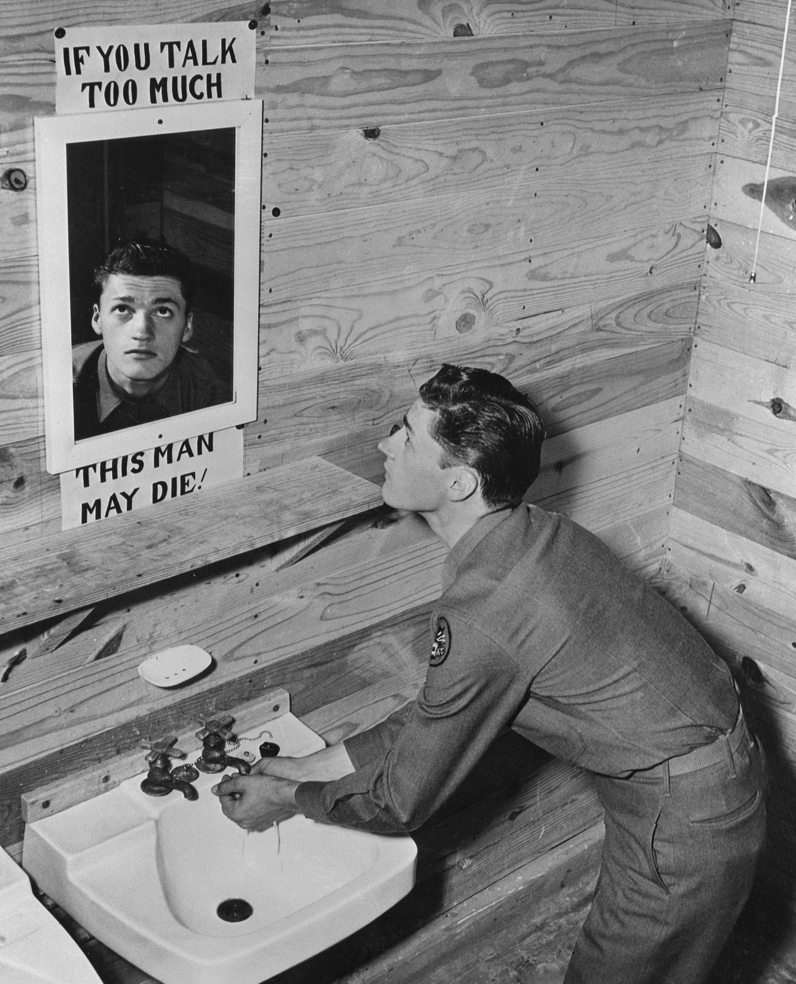

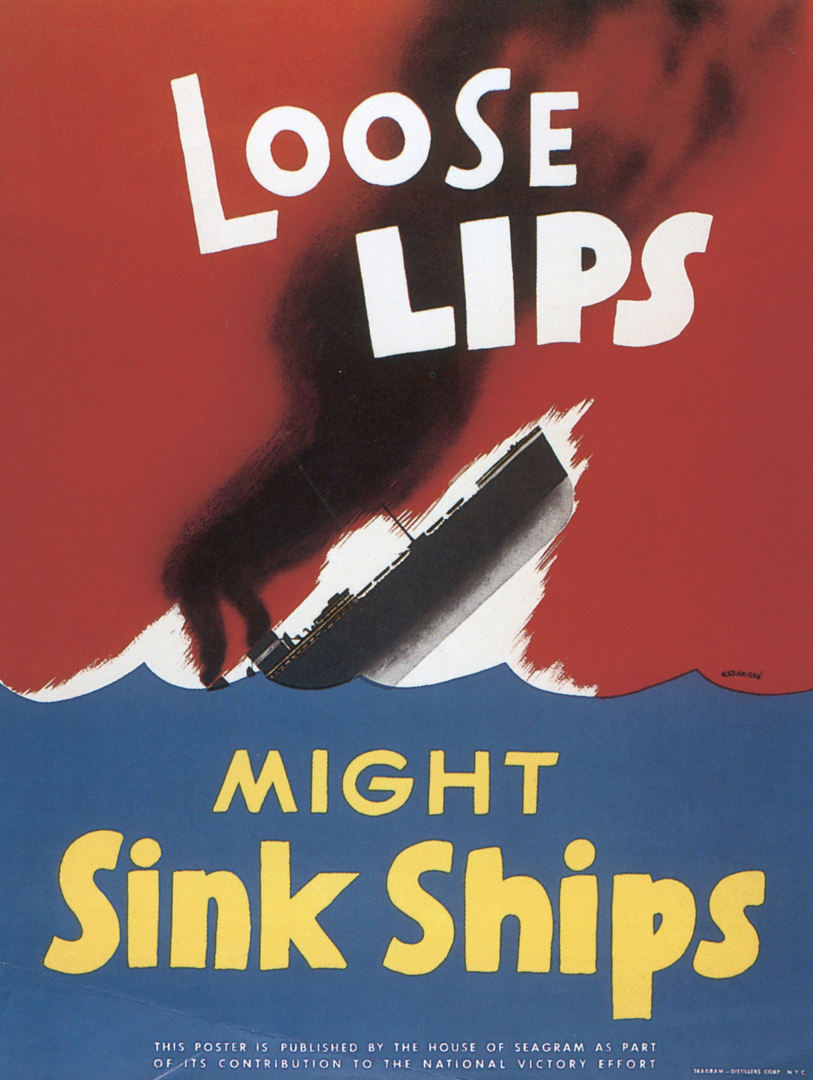
Military Secrets
Information kept from the general public as well as adversaries, in the interest of national security

Slide 12

U.S. Security Clearance
Revelation of secret information may cause serious damage to national security if disclosed without authorization
Revelation of top secret information may cause grave damage to national security if disclosed without authorization

Slide 13

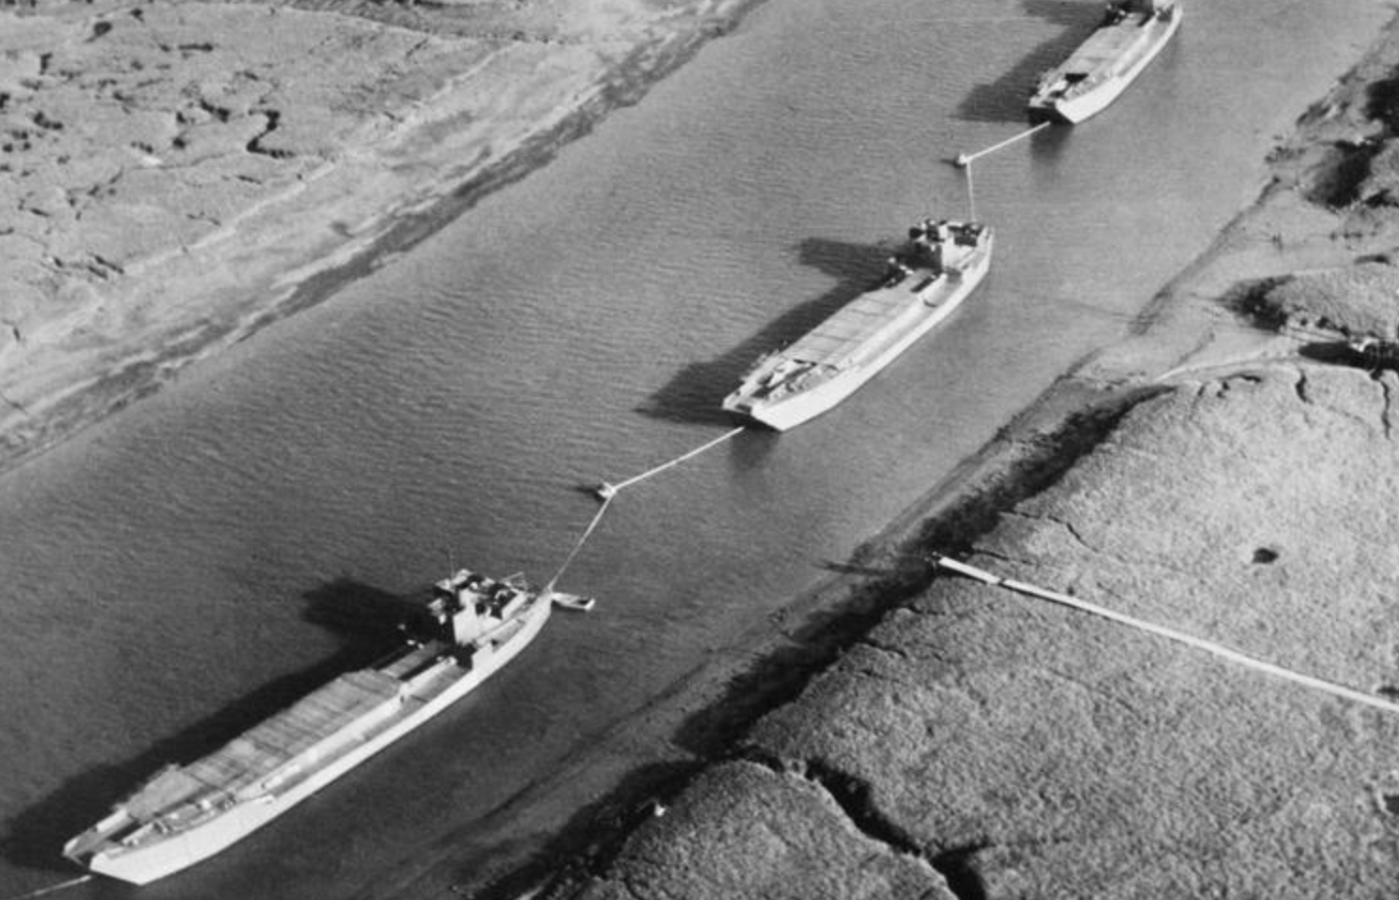
Operation Fortitude
Part of allied plan to conceal D-Day landing at Normandy
Created an entire fictional military force, the 1st Army Group
Leaked false information to spies, used radio deception to simulate movement of troops, displayed balloon landing crafts and vessels

Slide 14
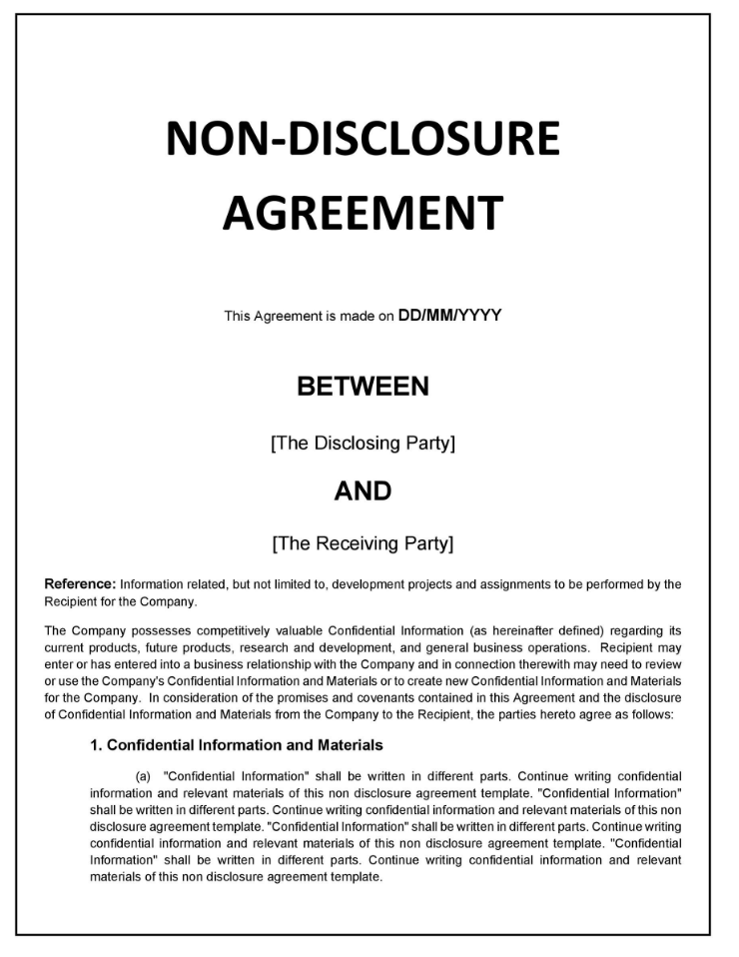


Secrets in the Wild
Healthcare provider-patient confidentiality
Attorney-client privilege
Data privacy
Non-disclosure agreements

Slide 15
Secrets and “Secrets”
The worst kept secret is that secrets are everywhere
We all conceal, we all withhold, and we all deceive at one more points in our lives
Secrets are a fixture of communication, social interactions, political engagement, military strategy, and economic protection
But not everything is a secret

Slide 16
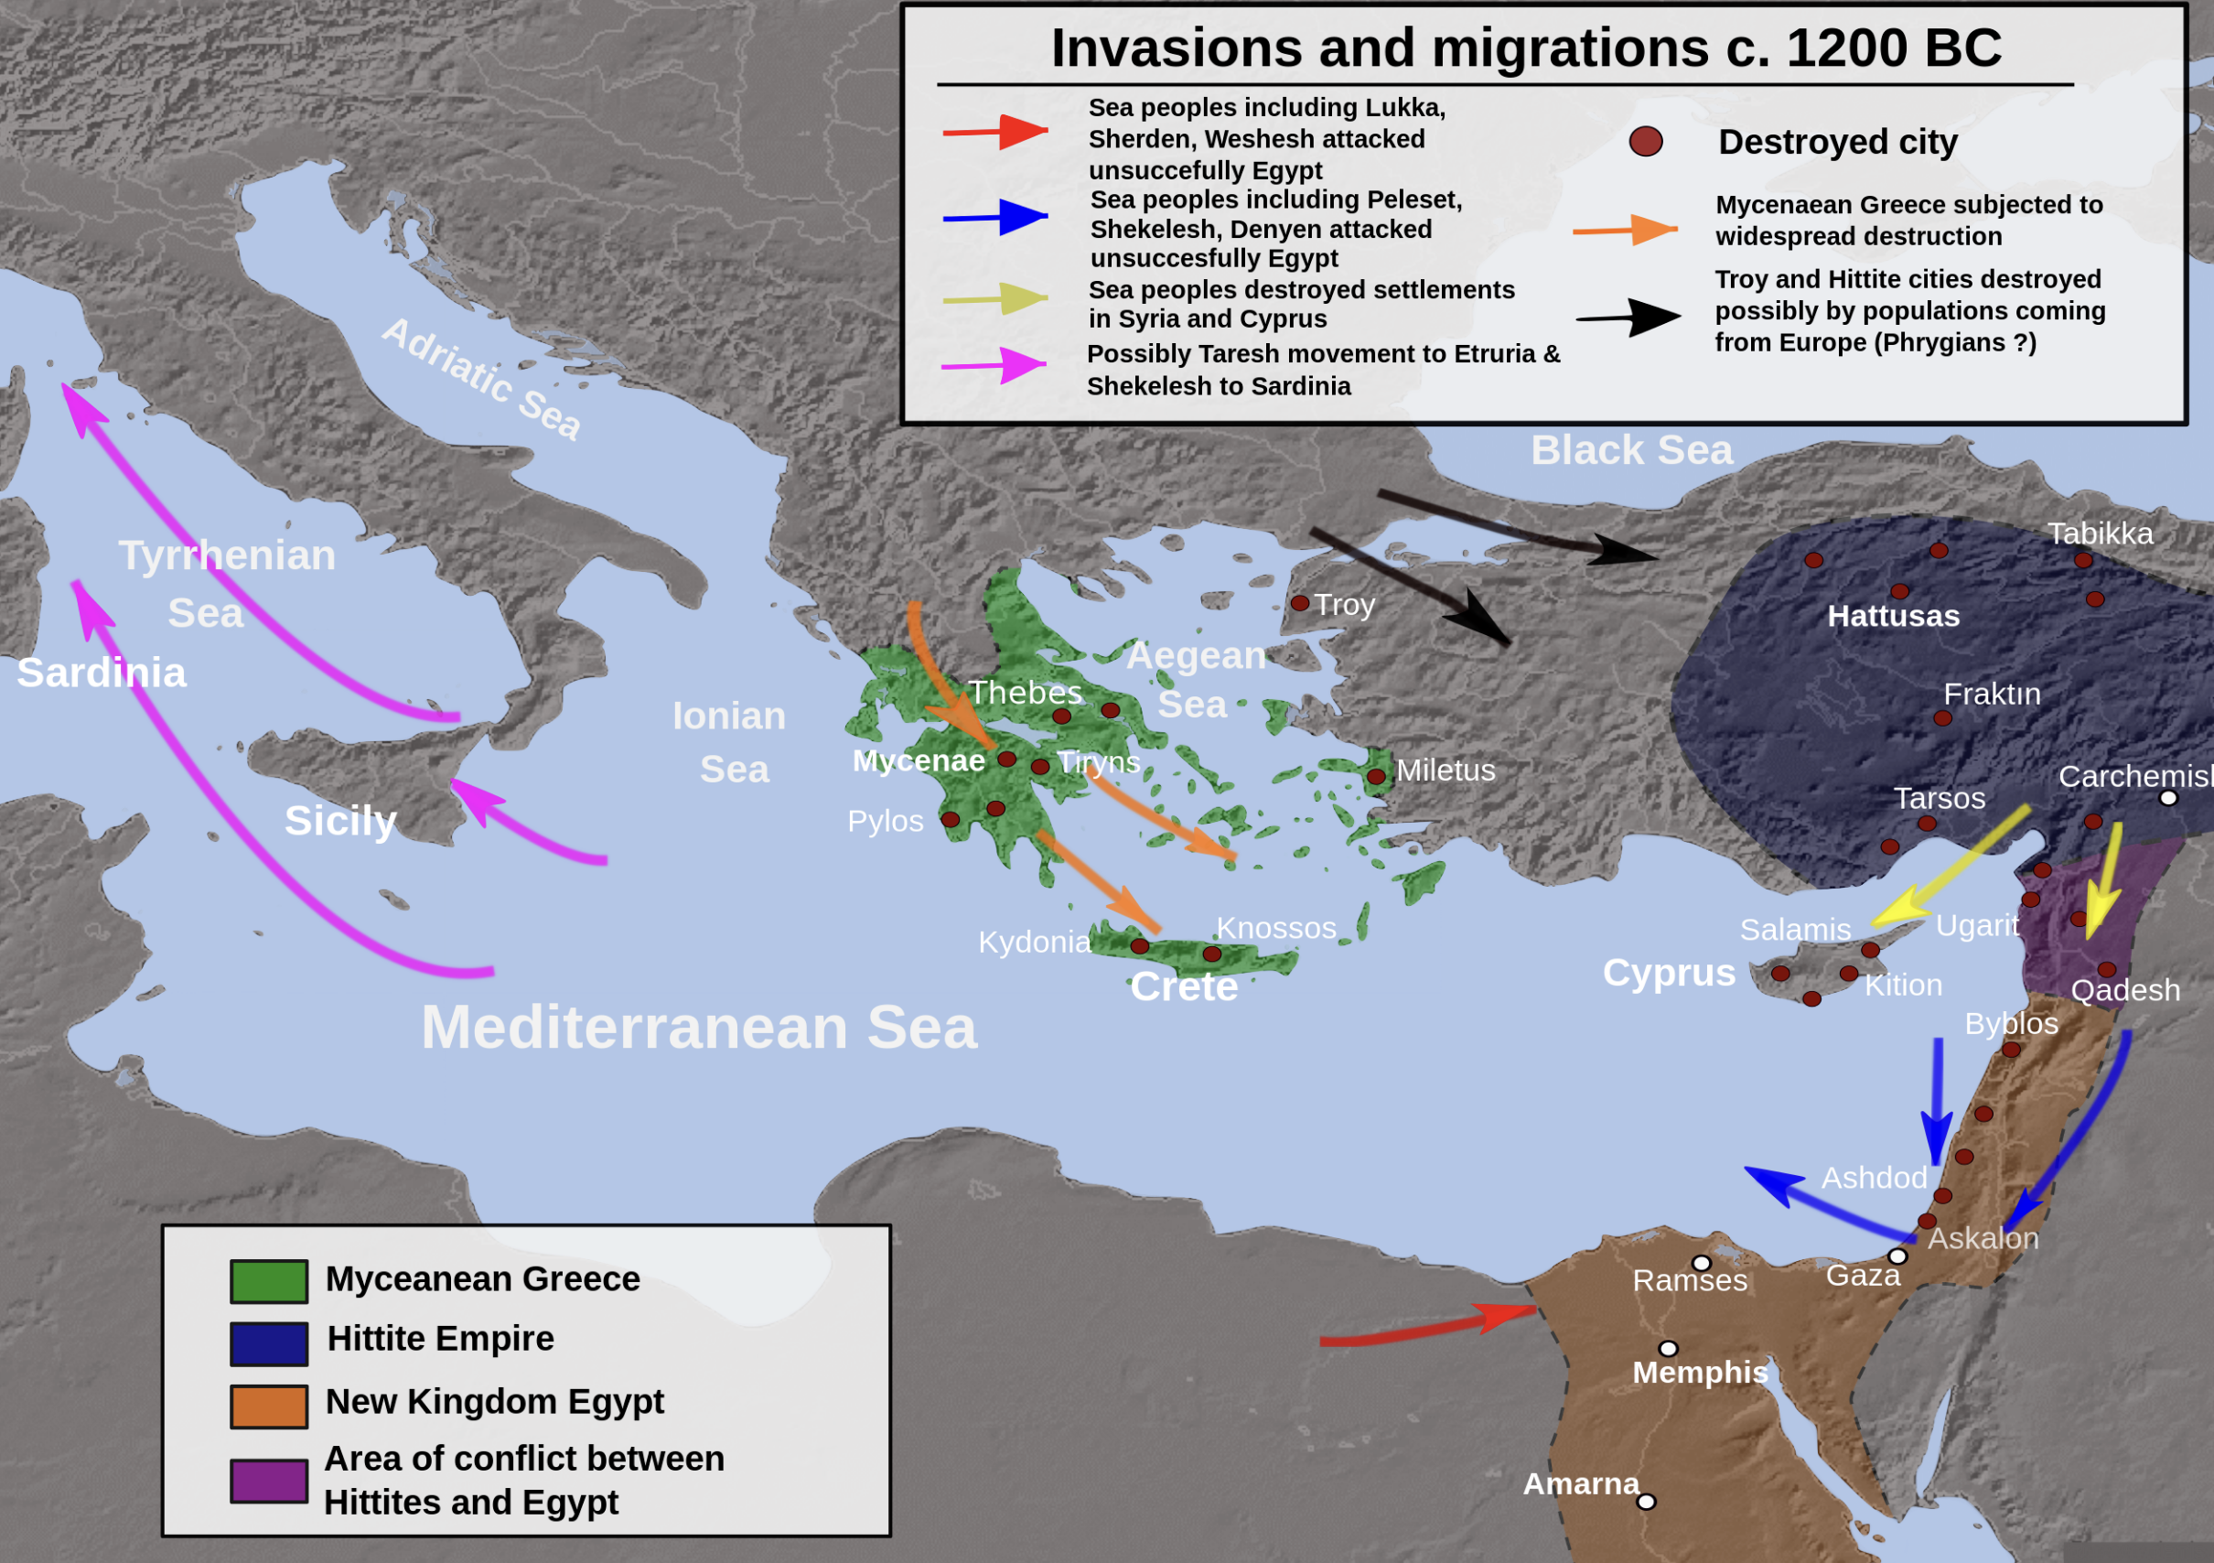
Historical “Secrets”
12th century BCE witnessed a massive societal collapse, involving the sudden destruction of major cities, mass migration
Precipitated a war waged against Egypt by the “Sea Peoples”, with the Egyptian victory being a point of pride for generations

Slide 17

Open “Secret”
Truman established the NSA in 1952
His order was classified and so intended to be kept secret from the public; Internally, “NSA” was jokingly referred to as “No Such Agency”
This open “secret” is now widely known

Slide 18
Secrets
Secrets play a vital role in the social world; they are instruments that can be used to promote or undermine our plans, to help or harm
Fundamentally, secrets are information
In other words, secrets are, in every case, about something

